Slide 1

Predicting Customer Buying Behavior
07/10/2023

Slide 2
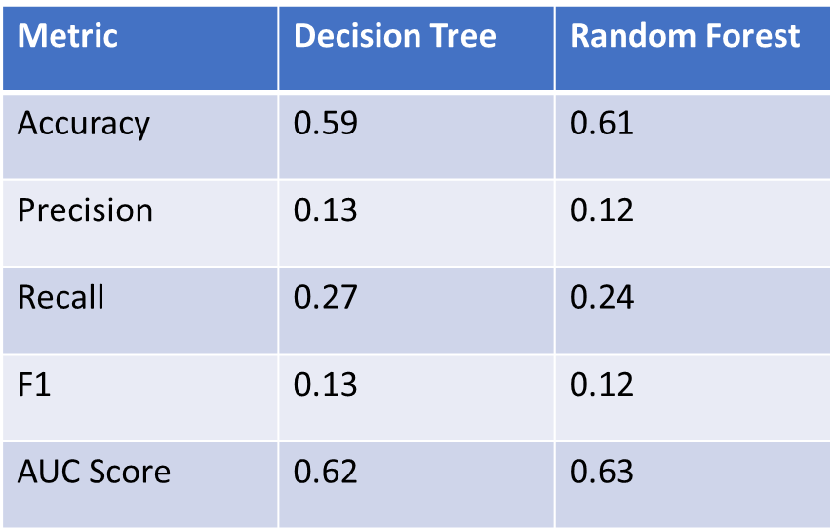
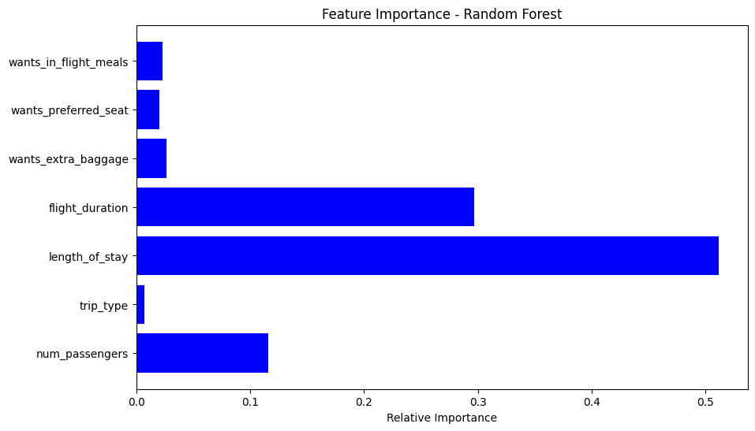
Insight from Customer Booking Data
Evaluation
AUC score for Decision Tree and Random Forest are 0.62 and 0.63 respectively, showing that this model requires more improvement. I suggest adding more customer-centric features into the model.
The most important variable in the model was length_of_stay, that is the time for the trip or trip duration.
Information about the flight, e.g., flight time and duration was also significant, however booking origin of the customer was not important.

